Slide 1

STORE SALES – TIME SERIES FORECASTING
Colin Tran

Slide 2

AGENDA
Project Summary
Exploratory Data Analysis(EDA)
Times Series Forecasting
Sales Prediction Using XGBOOST Supervised Learning

Slide 3

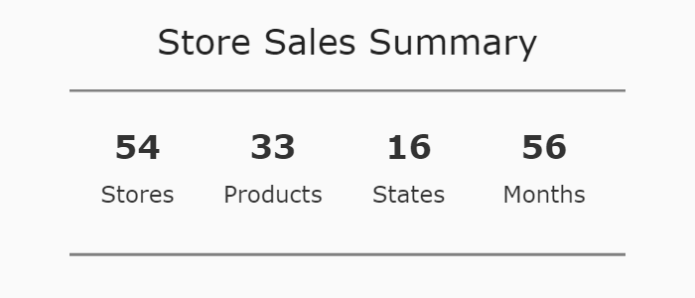
PROJECT SUMARY

Slide 4
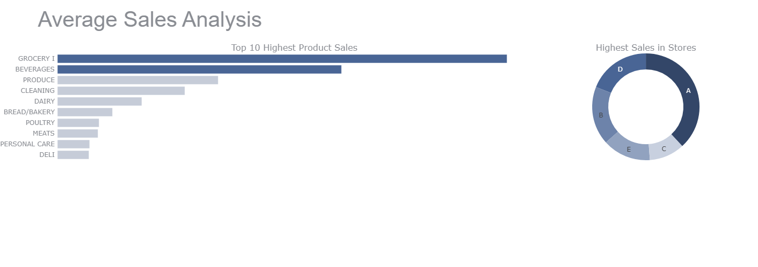
EDA
Highest sales are made by grocery and beverage products and store A has the highest sales which is 38%

Slide 5
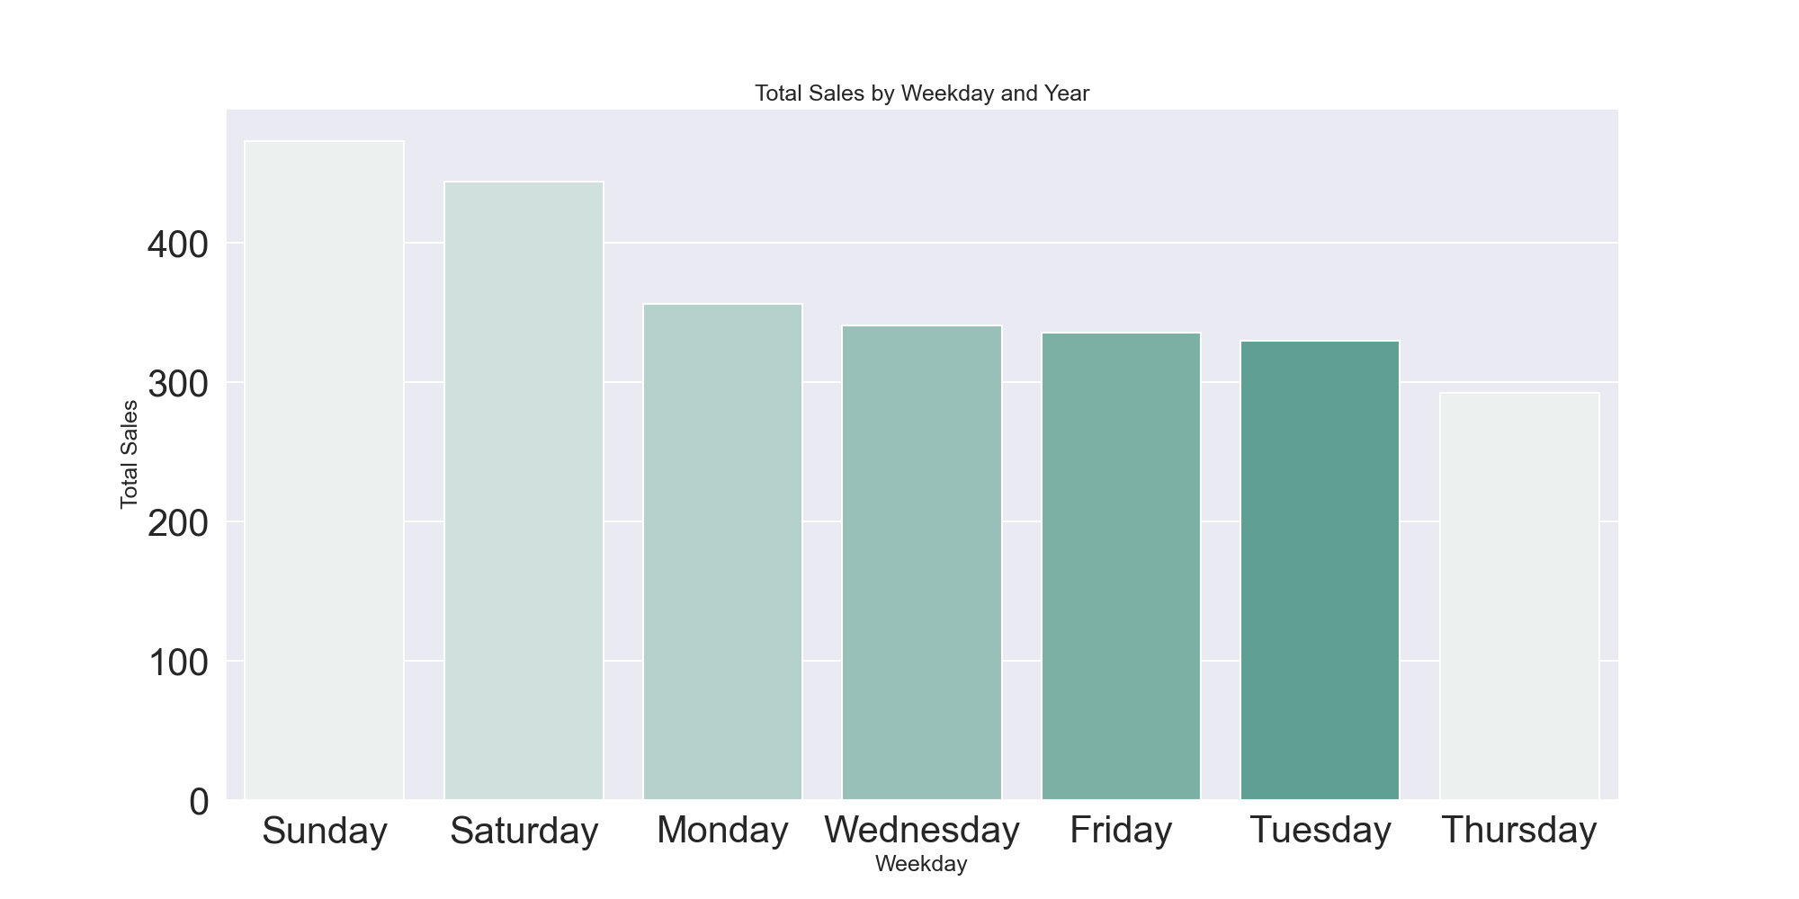
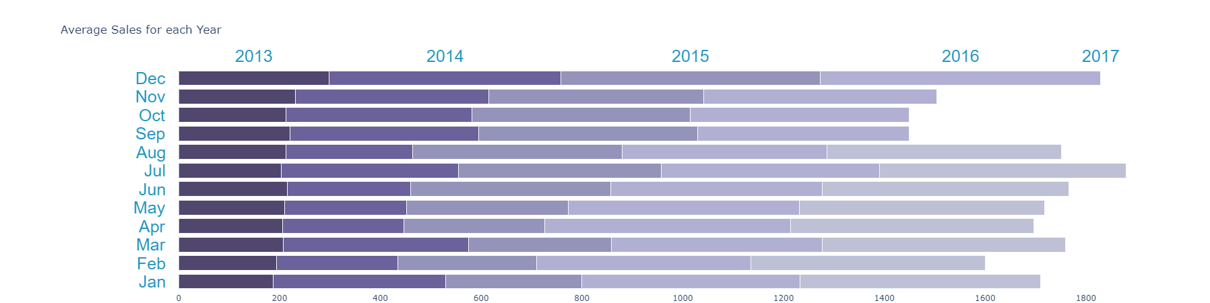
Highest sales are made in December and then decrease in January. Sales are increasing gradually from 2013 - 2017

Slide 6
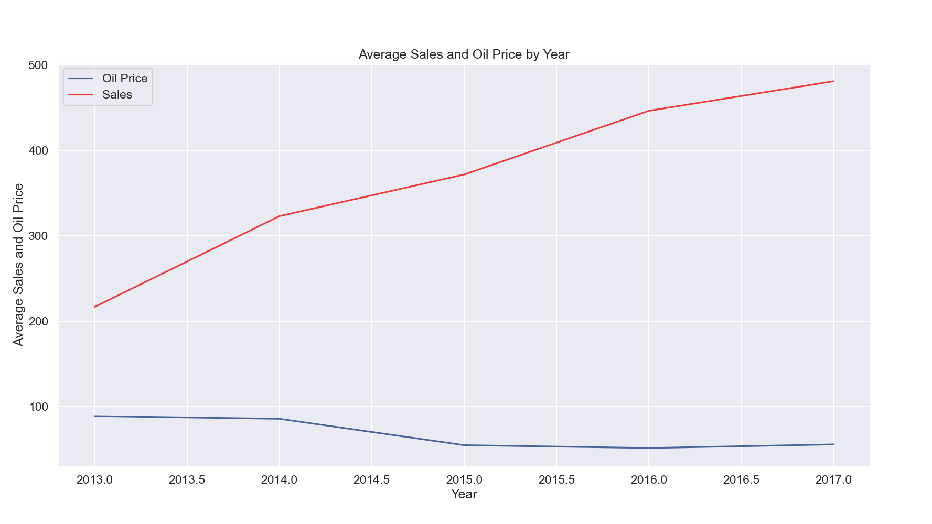
There is a negative correlation between oil price and sales. Pearson correlation coefficient(r) values: -0.058

Slide 7
Time Series Forecasting
Check Stationary
Decomposition
Validate Forecast
Forecasting

Slide 8
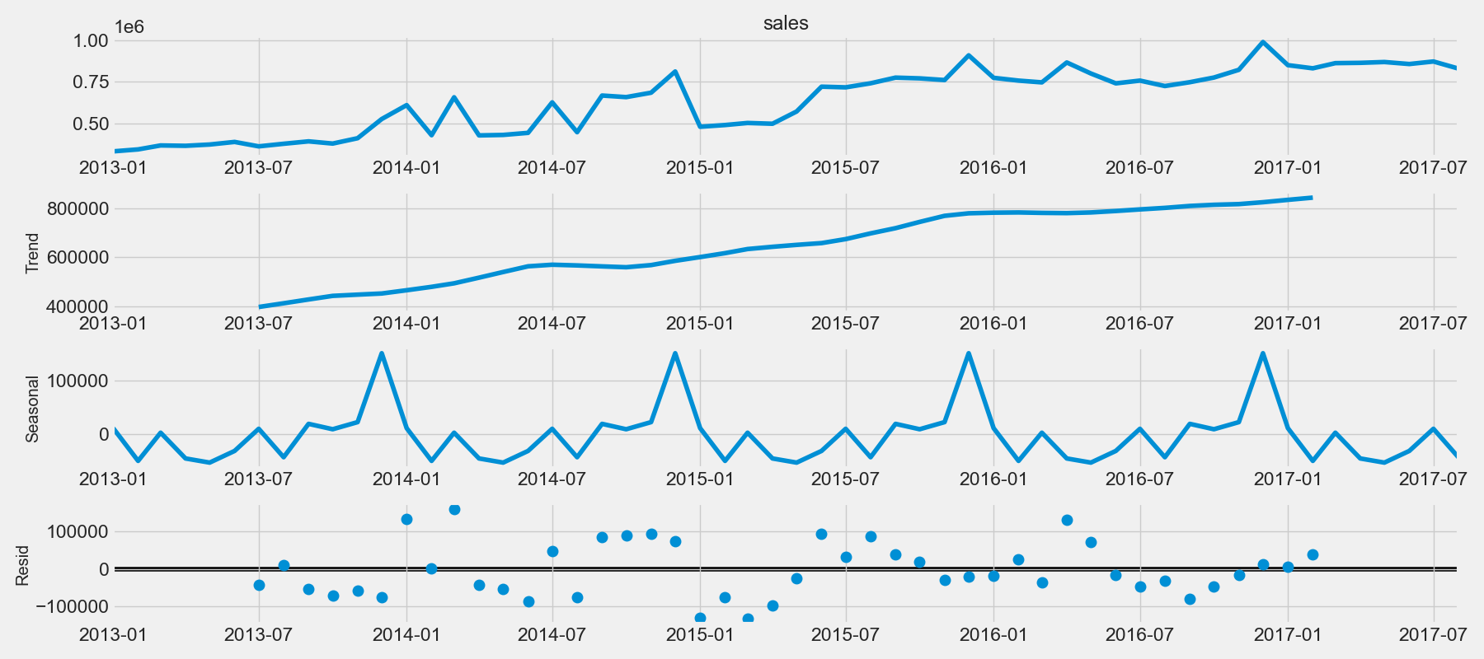
Decomposition
Notes:
Patterns appear when we decompose the series and plot the data. The time-series has seasonality pattern, peaking rightbefore year end. Sales had been trending upward troughout the year.

Slide 9
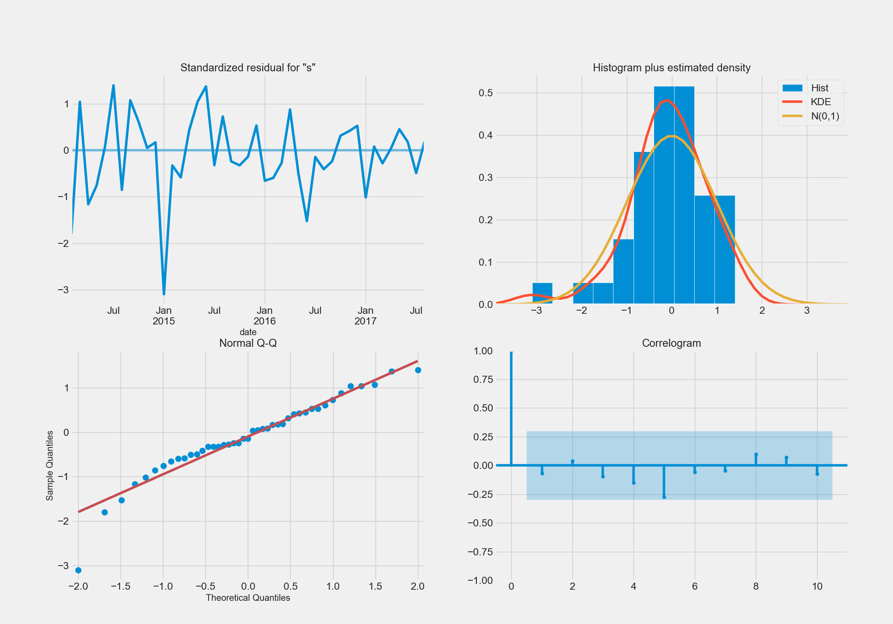
Notes:
Observations from diagnostics:
The residual errors fluctuate around a mean of zero and have a uniform variance.
The density plot suggest near normal distribution..
Most of the points fall in line with the red line. Distribution is not skewed. Normal data distribution is observed.
The Correlogram shows no autocorrelation on the residual errors.
Model is a good fit to proceed to forecasting.

Slide 10

Validate Forecast

Slide 11
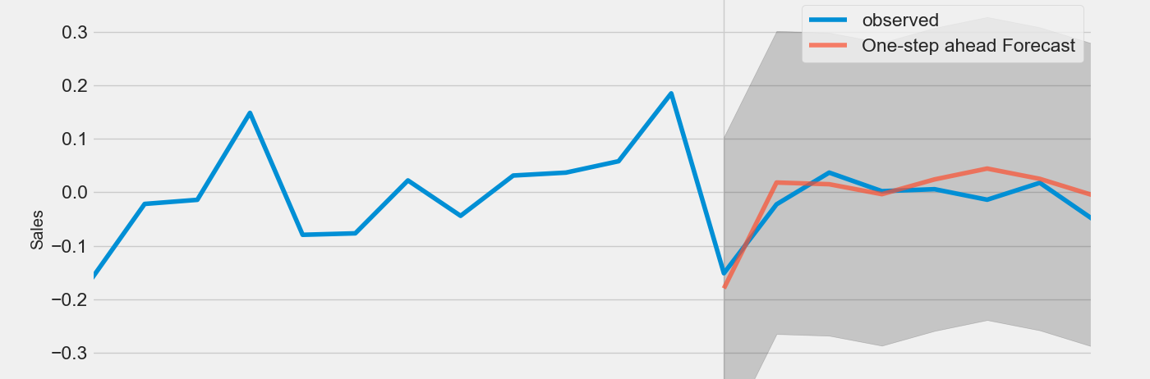
Notes:
To understand the accuracy of the forecast, predicted sales are compared to actual sales data. In the image below, forecast date is to start on 01-1-2017 to the end of the data. Based on the image below, forecast prediction looks acceptable as it follows the actual data closely.

Slide 12
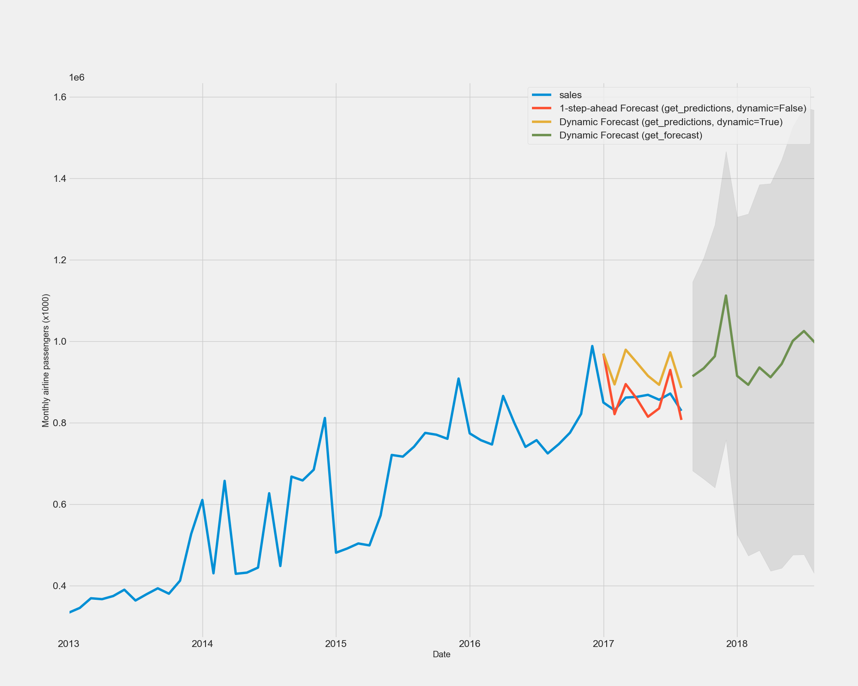
Forecasting
Forecasting looks acceptable as it follows seasonality of an upward trend in sales shortly before year end which similar to the previous years.
Notes:
Based on image above, forecast looks acceptable as it follows seasonality of a upward trend in sales shortly before year end similar to previous years.
In [19]:

Slide 13
Sales Prediction Using Supervised Learning
Cleaning Data
Feature Engineering
Modeling
Prediction
Evaluate

Slide 14
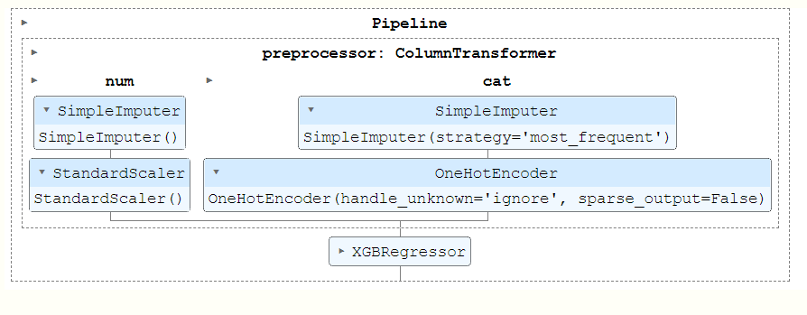

Slide 15
Validating and Comparing
 | Mean Square Error | Mean Absolute Percentage Error | Root Mean Squared Error
Time Series | 2854912236.01 | 0.05 | 53431.38
XGBOOST | 60875.58 | 354828436823303.3 | 246.73

Slide 16
Reference
https://www.kaggle.com/learn/intro-to-deep-learning
https://www.kaggle.com/code/dimitreoliveira/deep-learning-for-time-series-forecasting
https://www.kaggle.com/code/datafan07/time-series-analysis-forecast-with-visualization
https://machinelearningmastery.com/time-series-data-stationary-python/

Slide 17

Thank you for listening

